Slide 1
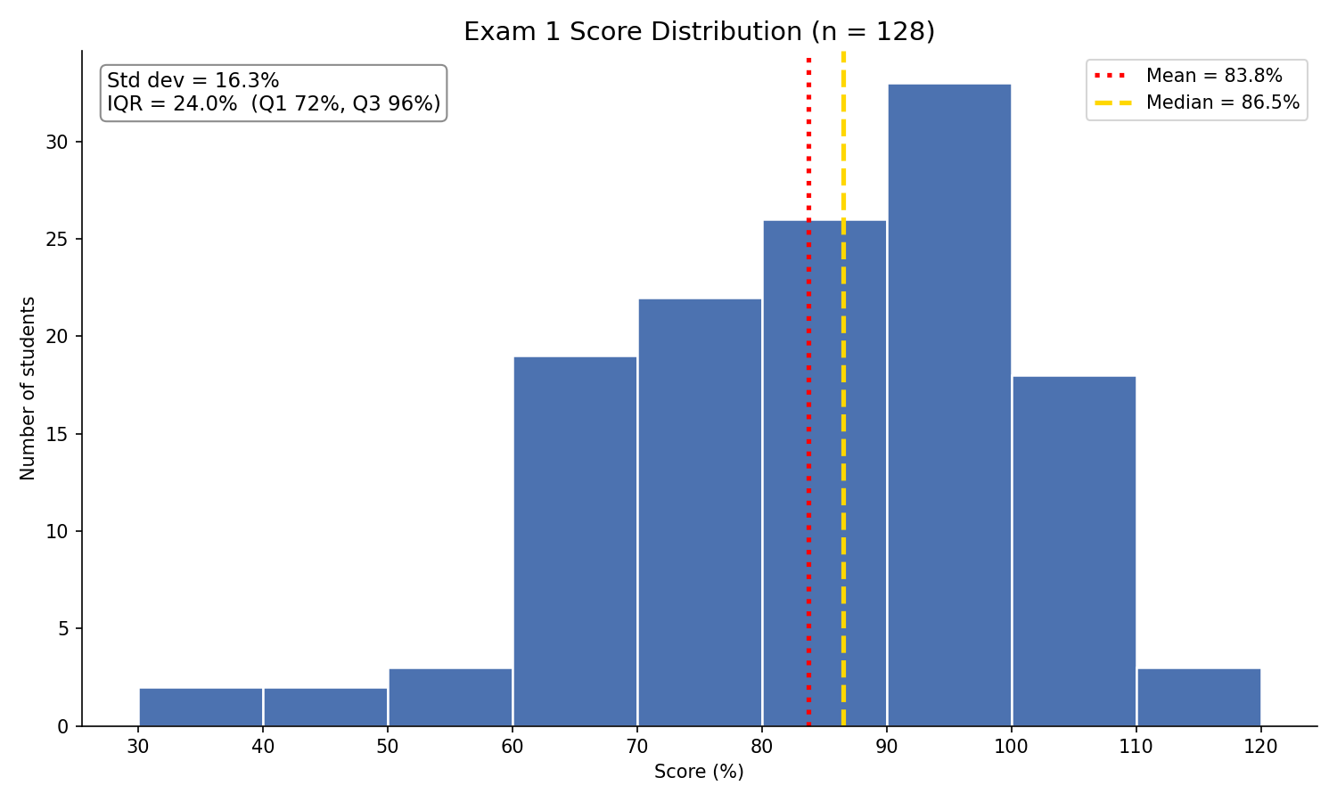
Exam 1 results

Slide 2
Lecture 10
Experiments and Causation

Slide 3
Review
1 What is a stratified random sample?
Split the population into groups of similar units (strata), then take a separate SRS inside every stratum.
2 What is a cluster sample?
Take an SRS of naturally occurring groups (clusters), then measure every unit in the clusters chosen.
3 What is a two-stage cluster sample?
Stage 1: an SRS of clusters. Stage 2: an SRS of units inside each chosen cluster, not all of them.

Slide 4
Review
4 What is undercoverage?
The sampling frame leaves part of the population out, so those units cannot be chosen at all.
5 What is nonresponse?
People who were chosen cannot be reached, or they refuse to answer.
6 What is response bias?
The answers themselves are wrong - leading questions, sensitive topics, or wanting to please the interviewer.

Slide 5
Your course project: Part 3
Part 3 asks you to draw a sample of 20 to 30 observations from your dataset
Pick a design: simple random, systematic, stratified or cluster sampling
Say exactly how you drew it - the method, n, and the tool - so someone else could repeat it
Justify the choice for YOUR data: is there a natural group to stratify on? natural clusters?
Name any bias your method could introduce
Steps 1 to 4 of the project can be started as soon as this lecture is finished

Slide 6
Part 2
Experiments and Causation

Slide 7
Observational studies and experiments
response variable
the outcome we measure
heart disease
explanatory variable
the variable we think explains or influences the response
hormone therapy (yes or no)
observational study
observe individuals and measure variables, without influencing anything
survey women about the hormones they chose to take
experiment
the researcher deliberately assigns treatments, then measures the response
randomly assign women to hormones or a placebo
Ask: who decided which group each unit ended up in? The units themselves -> observational. The researcher -> experiment.

Slide 8
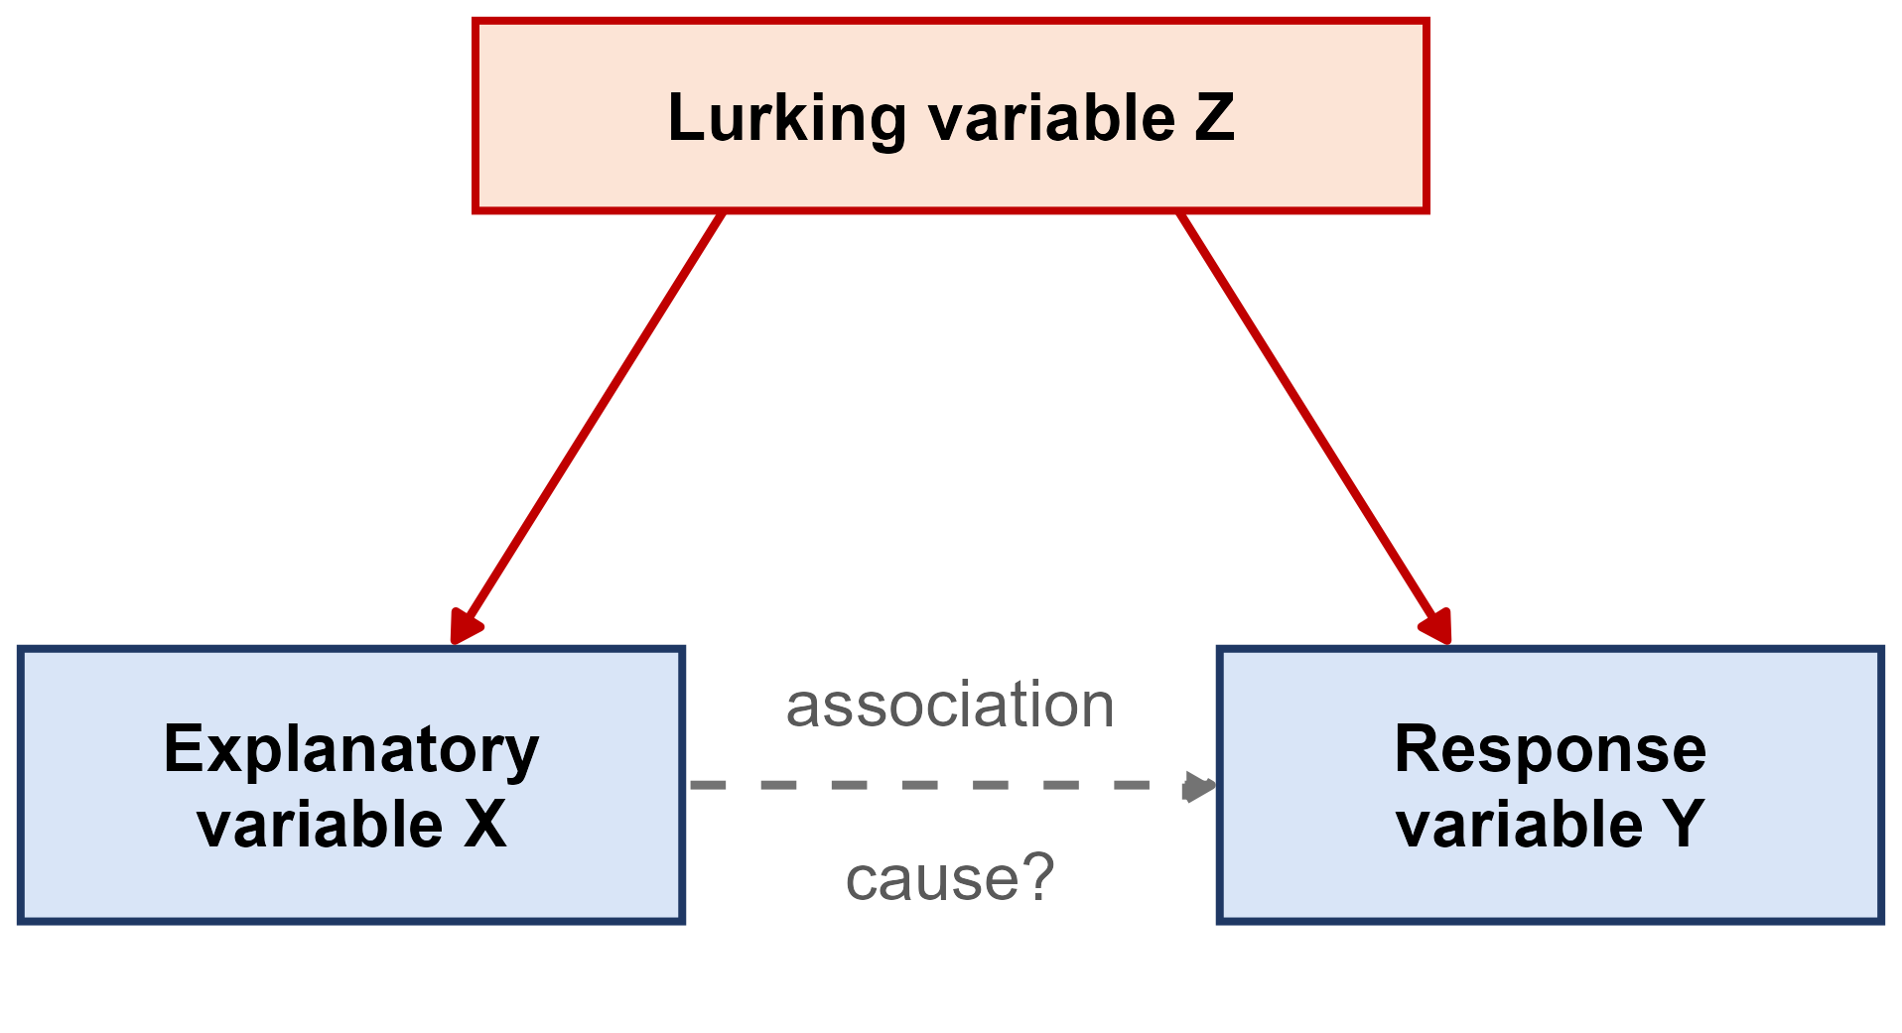
Association is not causation
association
two variables change together in the data
causation
changing one variable would change the other
lurking variable
a variable not in the study that influences both the explanatory and the response variable
confounded
two variables whose effects on the response cannot be separated
Ice cream sales and drownings rise together. The lurking variable: hot weather. The association is real - the causal story is not.

Slide 9
Hormone therapy and heart disease
Large observational studies, such as the Nurses' Health Study, found that women who took hormone therapy after menopause had less heart disease
The Women's Health Initiative then randomly assigned 16,608 women aged 50 to 79 to estrogen plus progestin or a placebo
It was stopped early in 2002 because the risks outweighed the benefits: more breast cancer, and MORE heart disease, not less
Why did the observational studies point the wrong way?
Lurking variables.
Women who chose hormone therapy tended to be wealthier, better educated and healthier to start with - and that,
not the hormones, lowered their heart risk. Random assignment balanced those differences out in the 2002.
The 2002 study however, did not have a representative population, nor did they consider dosage. This impacted their observations on cancer risk and heart disease risk.
More recent research has shown that HRT lowers heart disease risk if taken, at an appropriate dosage, during perimenopause or within 10 years of menopause onset.
Source: Writing Group for the WHI Investigators (2002), JAMA

Slide 10
Coffee and the risk of death
The NIH-AARP study followed 402,260 adults aged 50 to 71 from 1995 to 2008. Before adjusting for anything but age, men who drank 6+ cups of coffee a day had a 60% HIGHER risk of death than men who drank none
But 35% of those heavy coffee drinkers smoked, compared with 5% of the men who drank no coffee
After adjusting for smoking and other factors, the same men had a 10% LOWER risk of death - and fewer deaths from heart disease
Since then, better-adjusted studies point the other way: 5+ cups a day went with less cirrhosis and liver cancer (UK Biobank, 2026), and the AHA (2026) finds coffee either unrelated to or associated with LOWER heart disease
Why did the coffee effect flip?
Lurking variable: smoking.
Heavy coffee drinkers smoked far more, and smoking - not coffee - raised their risk. Even after adjusting, the authors say they cannot tell whether coffee itself helps.
Sources: Freedman et al. (2012), NEJM; Kim et al. (2026), Clin Gastroenterol Hepatol; Marcus et al. (2026), Circulation

Slide 11
Can we claim cause without an experiment?
Nobody can randomly assign people to smoke for thirty years - or randomly assign their birth order
Yet we are confident that smoking causes lung cancer. Decades of observational studies found:
  a strong association, found again and again in different populations
  a dose-response pattern: the more cigarettes, the higher the risk
  the right order in time: the smoking comes before the cancer
  a plausible biological explanation, backed by laboratory evidence
The 2014 Surgeon General's report: smoking causes at least 480,000 premature U.S. deaths a year, about 127,700 of them from lung cancer
Without an experiment, a causal claim needs this much evidence - never one study
Source: U.S. Department of Health and Human Services (2014)

Slide 12
Back to light at night and the heart
Recall the UK Biobank light-at-night study from Monday: 11,071 adults wore a wrist light sensor for 7 days in 2013-2015, then had a heart MRI about 3 years later.
1. Is this an observational study or an experiment?
Observational. Nobody was assigned a bright or a dark bedroom - the light people already had was measured.
2. People with the most light above 3 lux had 1.5% thicker heart walls than people with none. Did the light cause it?
This study cannot tell us. It shows an association - the authors say their design cannot establish cause.
3. The press release was titled “Too much light at night changes the shape and working of the heart.” Fair?
It goes too far. The paper says more night light was associated with these changes, not that it changed the heart.
Sources: Dai et al. (2026) and Münzel, Kuntic and Daiber (2026), European Heart Journal; ESC press release (2026)

Slide 13
Light at night: how strong is the evidence?
The authors adjusted for age, smoking, physical activity, BMI, air pollution, deprivation and more. The heart changes grew steadily as night light went up.
1. They adjusted for many variables. Is that as good as random assignment?
No. Adjusting only handles what was measured. Traffic noise was not, and the editorial says it could confound.
2. Which features from the smoking evidence does this study have? What is it missing?
Time order, a dose-response and a plausible link (shorter sleep). Missing: many studies finding it again.
3. The participants were volunteers, mostly White and healthier than average. Who can we generalize to?
Only people like them. Volunteers are not a random sample of any population.
Sources: Dai et al. (2026) and Münzel, Kuntic and Daiber (2026), European Heart Journal

Slide 14
The language of experiments
experimental units
the individuals or objects the treatments are applied to
subjects
experimental units that are people
factor
an explanatory variable the researcher controls
levels
the specific values a factor is set to
treatment
the condition a unit receives: one combination of factor levels

Slide 15
Example: the VITAL trial
VITAL randomly assigned 25,871 U.S. adults to vitamin D (2,000 IU a day) or a placebo, AND to omega-3 fish oil (1 g a day) or a placebo - nobody knew who got what - then followed them for about 5 years.
1. What are the experimental units - and what do we call them?
The 25,871 adults. They are people, so they are subjects.
2. What are the factors, and how many levels does each have?
Vitamin D and omega-3 - 2 levels each (the supplement or a placebo).
3. How many treatments are there?
2 x 2 = 4: vitamin D + omega-3, vitamin D + placebo, placebo + omega-3, placebo + placebo.
4. What kind of design is this, and is it blinded?
A completely randomized 2 x 2 factorial design, double blind and placebo controlled. Neither supplement lowered the rate of invasive cancer or of major cardiovascular events.
Source: Manson et al. (2019), New England Journal of Medicine

Slide 16
Principles of experimental design
control
compare the treatment against a control group, so the treatment is the only systematic difference between the groups
random assignment
let chance assign units to treatments - it balances the lurking variables we know about AND the ones we do not
replication
put enough units in each group that chance differences between the groups average out

Slide 17
Placebos and blinding
placebo
an inactive treatment that looks exactly like the real one
a sugar pill, or a saline injection
placebo effect
people often improve simply because they believe they are being treated
in one study, believing you had taken a performance drug worked almost as well as the drug itself
blinding
the subjects do not know which treatment they received
double-blind
neither the subjects nor the researchers working with them know who received what

Slide 18
The 2020 Pfizer-BioNTech vaccine trial
43,548 people were randomly assigned, half and half, to two shots of the COVID-19 vaccine or two shots of a saline placebo. Participants and the staff assessing them did not know who got which. Afterwards: 8 COVID-19 cases in the vaccine group, 162 in the placebo group.
1. Why give the control group a saline shot instead of no shot at all?
So both groups have the same experience. A difference in cases can then only come from the vaccine, not from expectations.
2. Why randomize, instead of letting people choose whether to get the vaccine?
People who choose a new vaccine may also be more careful in other ways - a lurking variable. Randomizing balances it.
3. What does 8 cases versus 162 suggest?
The vaccine group had about 95% fewer cases - and because of the design, we can credit that to the vaccine.
Source: Polack et al. (2020), New England Journal of Medicine

Slide 19
A placebo surgery
Arthroscopic knee surgery for arthritis was common, and patients said it helped
Moseley and colleagues (2002) randomly assigned 180 patients with knee osteoarthritis to two real arthroscopic procedures, or to placebo surgery - skin incisions only, with no instruments inserted
Patients, and the staff who assessed their pain, did not know who got which
Over two years, which group reported the most improvement?
None of them.
The placebo group did as well as both surgery groups on pain and function. The benefit came from believing
you had surgery - and without a placebo group and blinding, nobody would have known.
Source: Moseley et al. (2002), New England Journal of Medicine

Slide 20
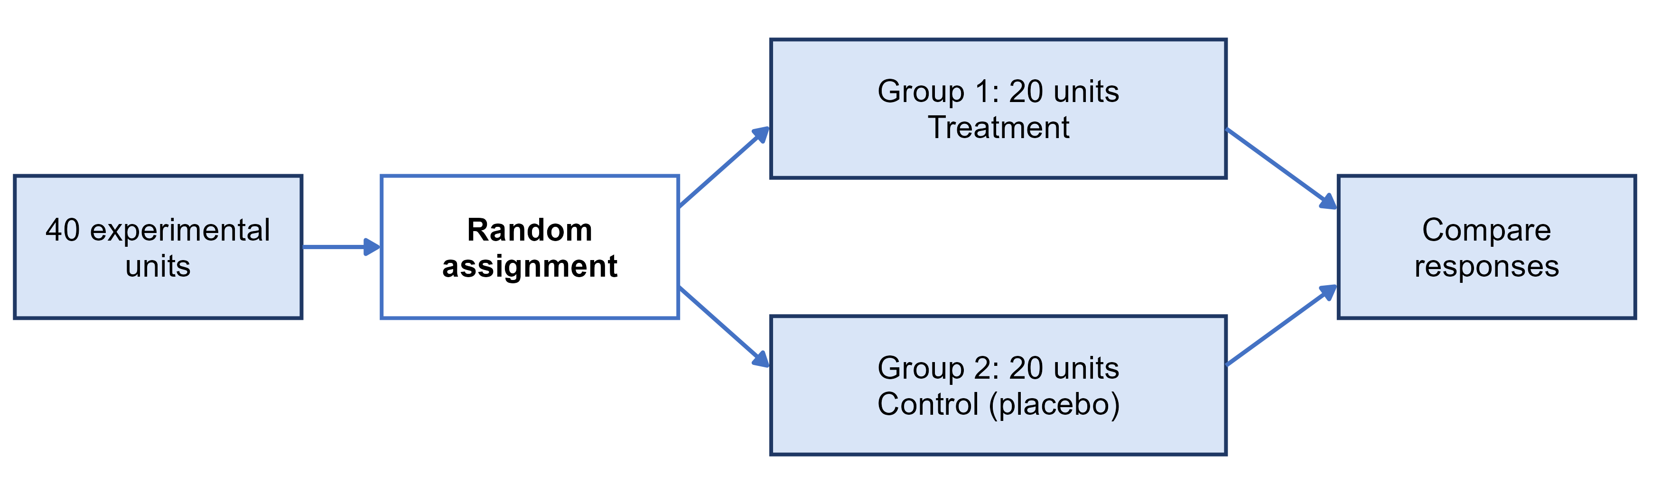
Completely randomized design
completely randomized design
every unit is assigned to a treatment completely at random - the simplest design
The Pfizer-BioNTech vaccine trial was a completely randomized design with two groups

Slide 21
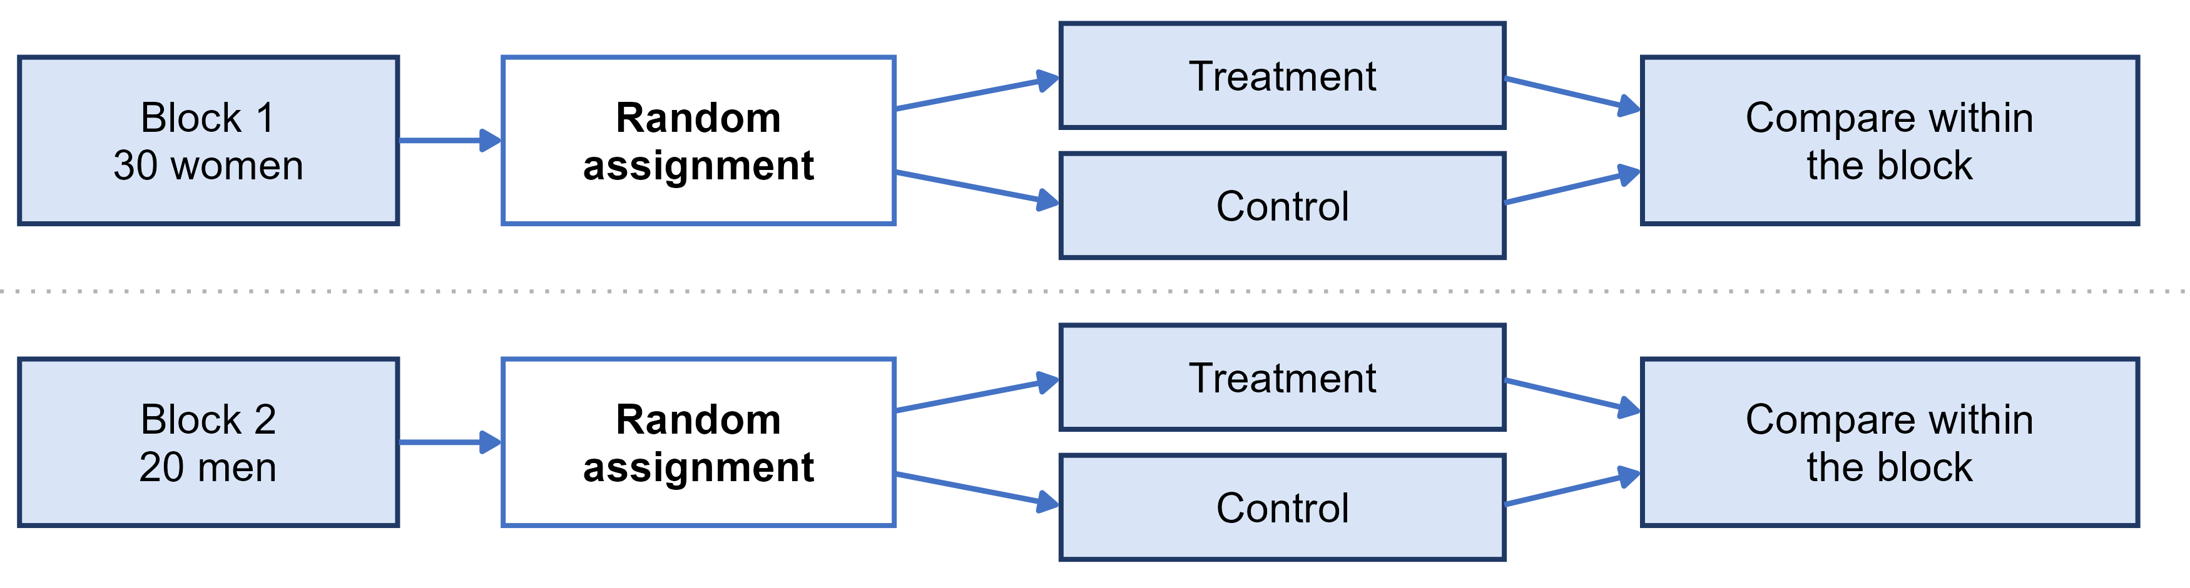
Randomized block design
block
a group of units that are alike in a way that affects the response, formed BEFORE treatments are assigned
randomized block design
randomize treatments separately inside each block, then compare treatments within blocks
blocking is to experiments what stratifying is to sampling

Slide 22
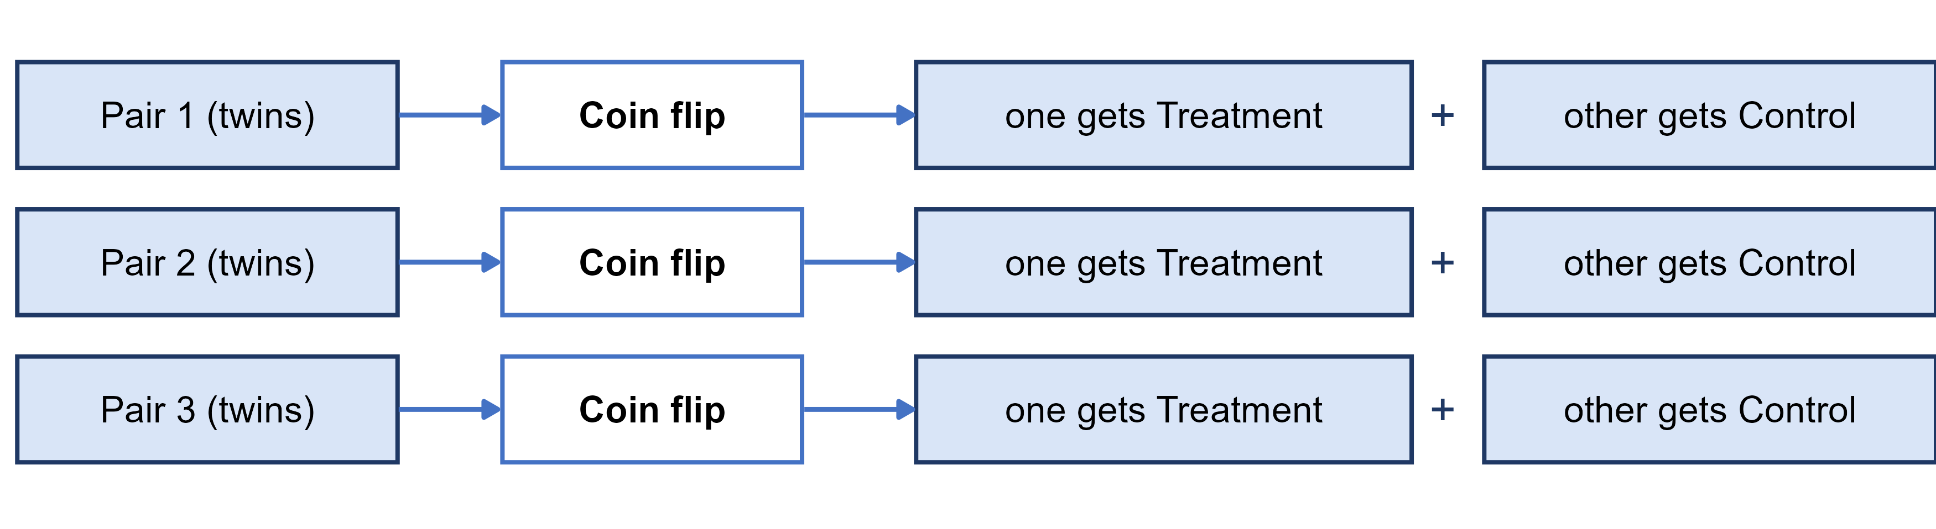
Matched pairs design
matched pairs design
a block design where every block is a pair of very similar units, and a coin flip decides which one gets each treatment
or each subject is their own pair, receiving both treatments in a random order
Before-and-after data with no random order or control group is much weaker evidence

Slide 23
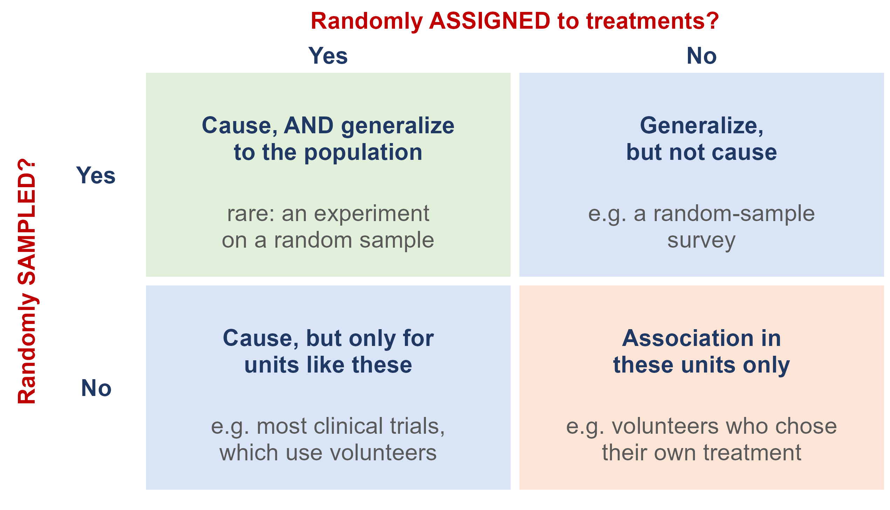
What does randomization buy you?
Random sampling lets you generalize from the sample to the population
Random assignment lets you conclude cause and effect
Most studies have only one. A trial on volunteers shows a vaccine works - for people like those volunteers

Slide 24
Ethics: the Facebook experiment
For one week in January 2012, Facebook changed the News Feeds of 689,003 users: some saw fewer positive posts, some fewer negative ones. The results were published in 2014. The users never knew.
1. Facebook said agreeing to its Data Use Policy counted as informed consent. Do you agree?
The journal did not: its Expression of Concern said the study may not have met the principles of informed consent and the chance to opt out.
2. Why did no ethics board stop it?
Facebook, a private company, was not bound by the federal rules. Cornell's board decided its researcher was not directly involved, so it did no review.
3. What is the lesson?
Clicking I agree on a terms-of-service page is not informed consent - even for a well-designed experiment.
Sources: Kramer, Guillory and Hancock (2014), PNAS; PNAS Editorial Expression of Concern (2014)

Slide 25
The Belmont Report: three principles
Why the rules exist: in the U.S. Public Health Service syphilis study at Tuskegee (1932 to 1972), hundreds of Black men with syphilis were left untreated without informed consent. The Belmont Report (1979) followed.
respect for persons
people decide for themselves whether to take part
beneficence
do no harm: maximize the possible benefits and minimize the possible risks
justice
the burdens and benefits of research are shared fairly

Slide 26
Research ethics today
informed consent
subjects are told the purpose, procedures and risks in advance, and can refuse or quit at any time
confidentiality
information about individuals is protected and never released in a form that identifies them
Institutional Review Board (IRB)
reviews and approves studies on human subjects before they start
at UI, through the Office of Research Assurances

Slide 27
Ethics: honest data
Ethics also means honest data. An investigation of psychologist Diederik Stapel, infamous social psychologist, found he had invented data: it tainted more than 55 of his papers and 10 PhD dissertations he supervised. A researcher is surveying households in a community:
Source: Introductory Statistics 2e (OpenStax), Section 1.4 and Example 1.22

Slide 28
Practice: what design, and can it show cause?
1. A survey finds that people who own dogs have lower blood pressure than people who do not.
Observational - nobody was assigned a dog. Active people may both own dogs and have lower blood pressure.
2. 60 volunteers with insomnia are randomly split: 30 get melatonin, 30 get an identical-looking placebo.
Completely randomized experiment - it can show cause, for people like these volunteers.
3. In each of 4 greenhouses, tomato plants are randomly assigned to fertilizer A or fertilizer B.
Randomized block design, with greenhouses as the blocks - it can show cause.

